Slide 1
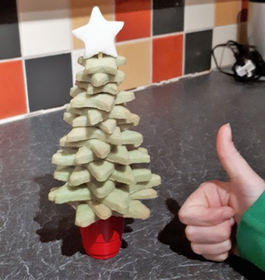
Make your own Biscuit Christmas Tree!
By Jen Thwaite (with support from SymbolStix!)

Slide 2
I’m Jen.
My mum works at the Ace Centre, and she’s asked me to show you how to make a biscuit Christmas tree.
make
Notes:
How make biscuit Christmas Tree

Slide 3
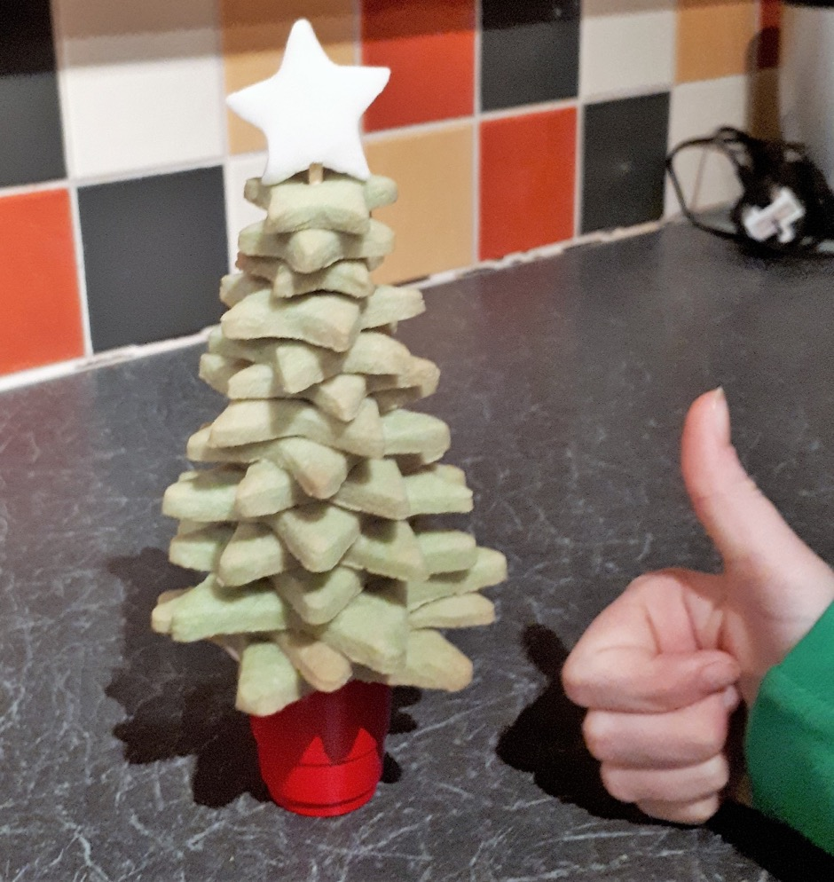
The biscuits are delicious.
You can have a biscuit star on top of the tree, but I prefer one made from icing.
delicious
Notes:
Biscuits are delicious

Slide 4
Ingredients
115g unsalted butter (softened)
55g caster sugar
Few drops of vanilla extract
150g plain flour
25g cornflour
Some green food colouring
A bit of ready-to-roll icing
Wooden spoon
Mixing bowl
Clingfilm
Rolling pin
Star shaped cookie cutters
Greaseproof paper
Bamboo skewer
Weighted base for your tree
Notes:
Ingredients. Butter Sugar Vanilla
Flour
Cornflour
Green food colouring Icing
Spoon
Bowl
Cling Film
Rolling Pin
Star Cutters
Greaseproof Paper
Bamboo
Base tree

Slide 5
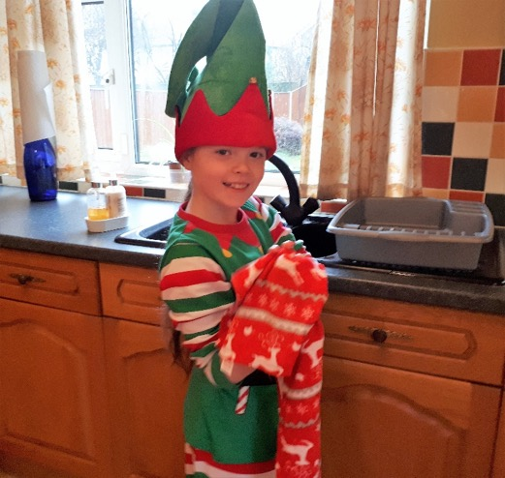
Get ready!
Turn the oven on to 180C / Gas Mark 4.
Wash your hands!
Turn
on
Wash
hands
Notes:
Ready? Turn Oven 180C Wash hands

Slide 6
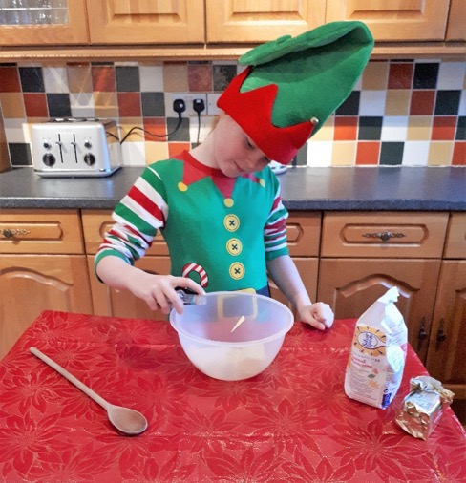
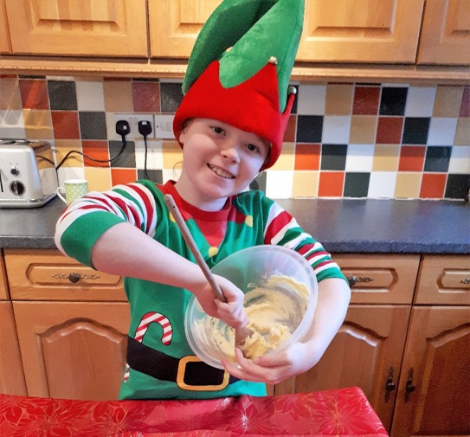
Mix
Put the softened butter, caster sugar and vanilla extract into a bowl.
Mix them together to form a smooth paste.
Put
Mix

Slide 7
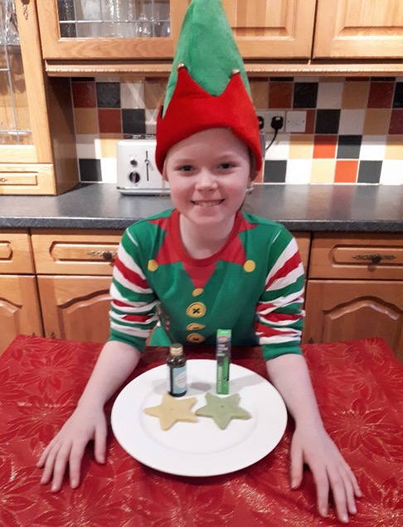
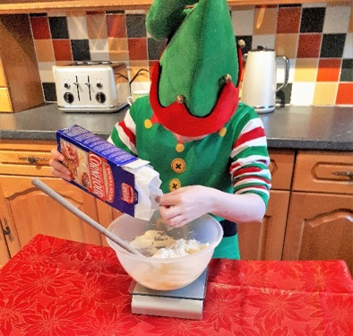
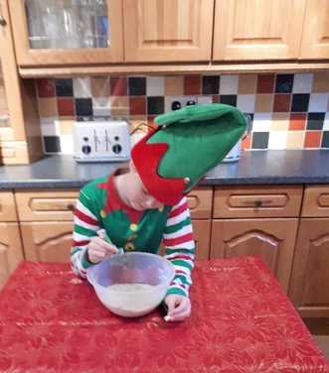
Add colour
Add in the plain flour, cornflour and a good few drops of green food colouring.
You can use either liquid or gel food colouring, but the gel will give you a darker green colour.
Add

Slide 8
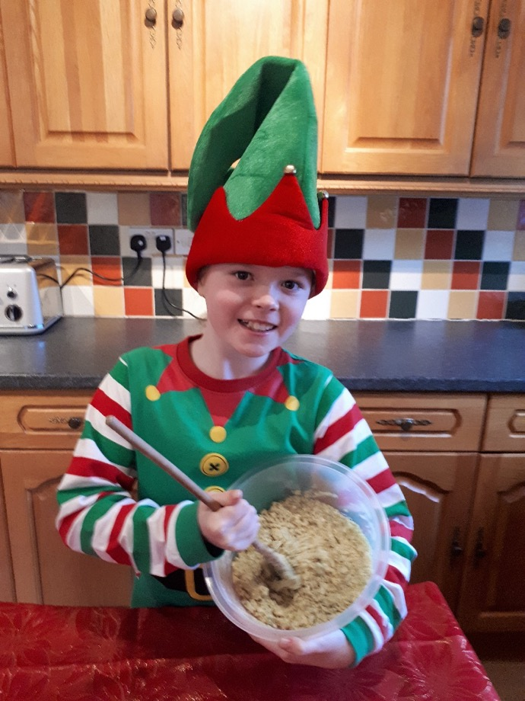
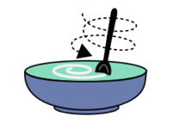
Stir
Stir the mixture until there are no big lumps left and the food colour has been mixed in.
Stir

Slide 9
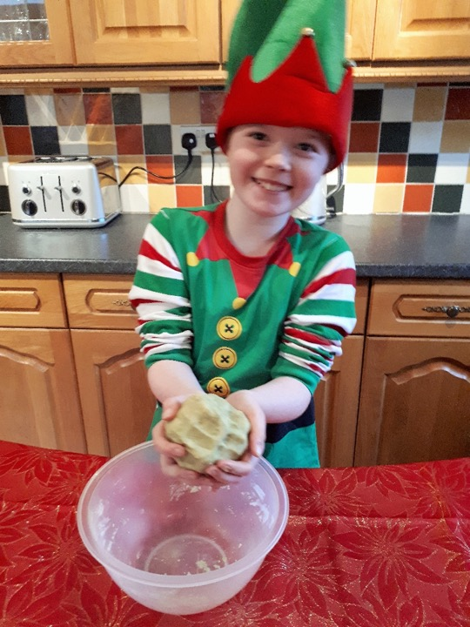
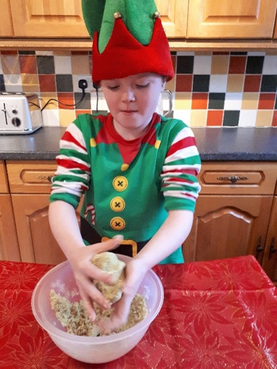
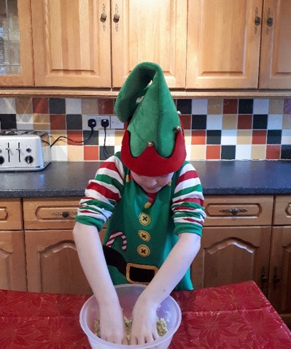
Make a ball
Spoon down, sleeves rolled up and hands in.
Squeeze the mixture together until you have a smooth ball of dough.
rolled
Squeeze

Slide 10
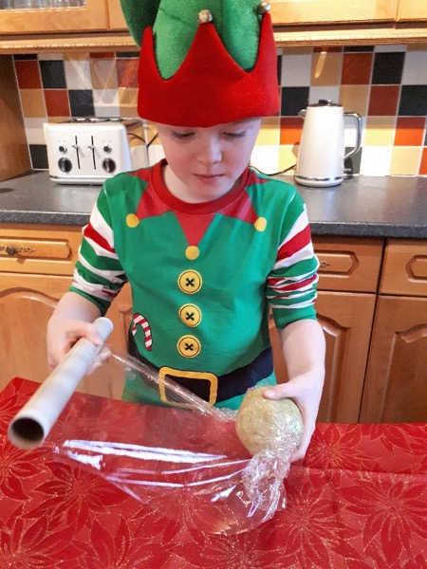
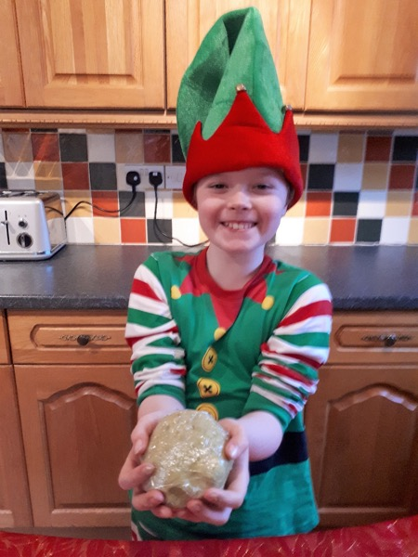
Wrap & chill
Wrap the dough in clingfilm and put it in the fridge to chill for 30 minutes.
Wrap
Put
fridge

Slide 11
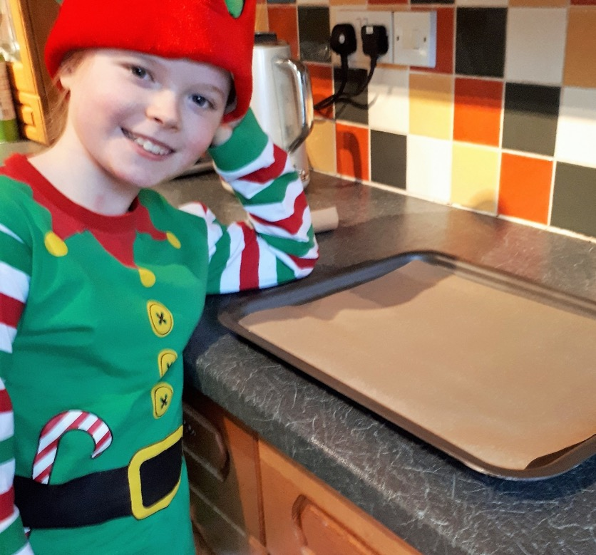
Line tray
Line a baking tray with greaseproof paper.
Line
Notes:
Baking paper on Tray

Slide 12
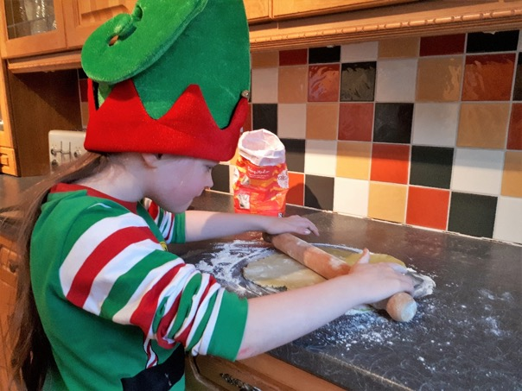
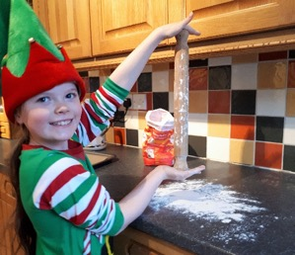
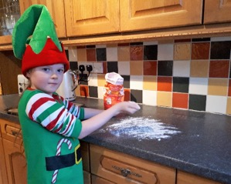
Roll dough
Sprinkle some plain flour onto a flat surface and on your rolling pin so that the dough doesn't stick.
Roll out your dough until it's the same thickness as a £1 coin.
Sprinkle
Roll

Slide 13
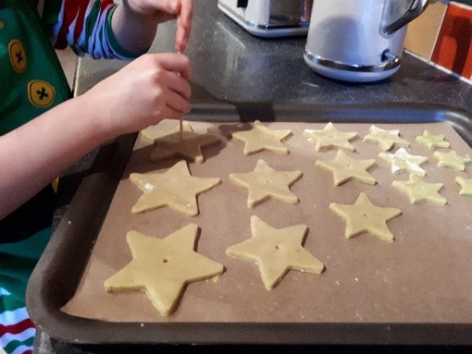
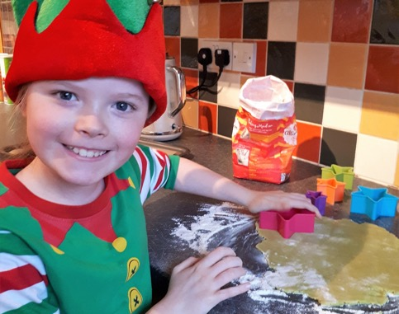
Cut biscuits
Cut out your biscuits and place them on the greaseproof paper.
Make sure they aren't touching each other.
For our tree, we're using 5 different size star cookie cutters and making 3 biscuits of each size, but you can make as many biscuits as you like - it just depends how big you want your tree to be.
Cut

Slide 14
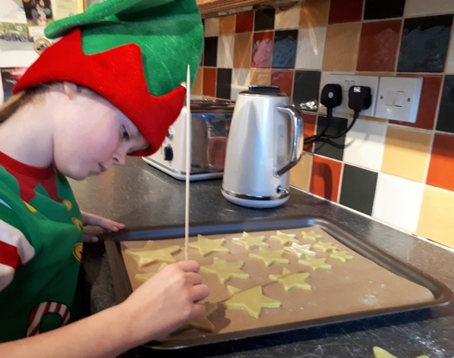
Make a hole in each star
BEFORE you cook your biscuits, use the blunt end of your bamboo skewer to make a hole in the centre of each biscuit.
It's much better to do it while the dough is still soft because after they're cooked the biscuits are more likely to break.
make
hole
Notes:
Hole Star

Slide 15
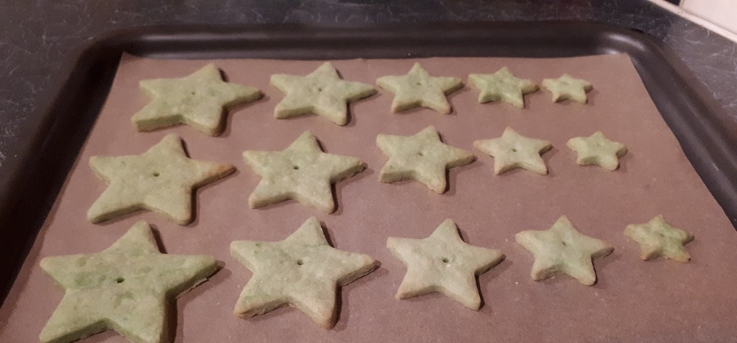
Put in oven for 10 minutes
Place your biscuits into the centre of your pre-heated oven, and cook for 8 to 10 minutes.
When ready, your biscuits should be slightly golden around the edges.
cook
Notes:
Oven 10 minutes

Slide 16
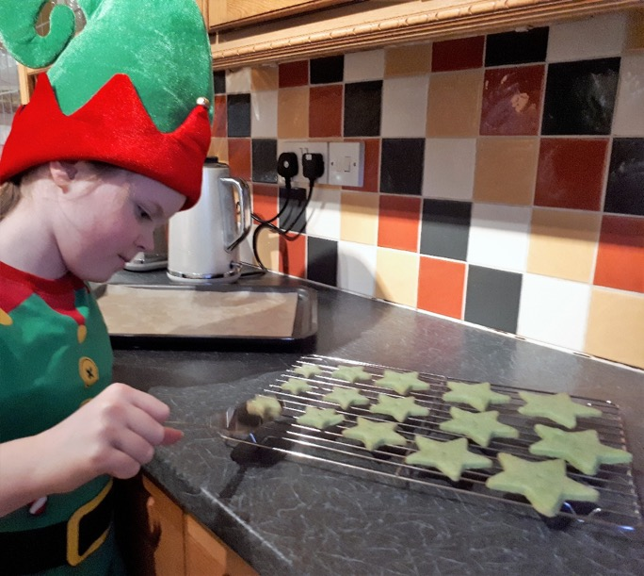
Leave to cool
Leave the biscuits on the baking tray for a couple of minutes, and then carefully transfer them to a wire rack to cool.
cool
Notes:
Leave cool

Slide 17
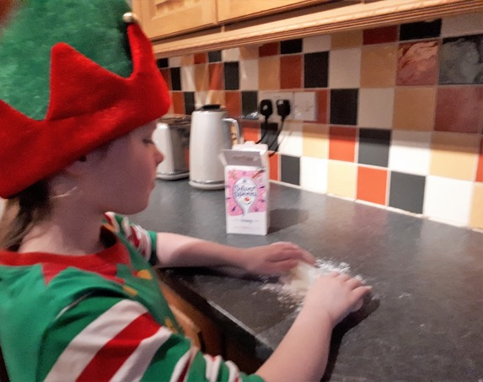
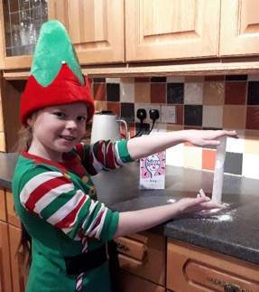
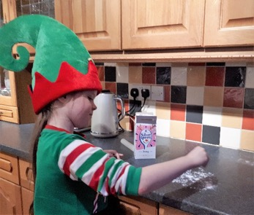
Roll icing sugar
Sprinkle some icing sugar onto a flat surface and on your rolling pin so that the ready-to-roll icing doesn't stick.
Roll out your icing until it's 1cm thick.
Roll
Notes:
Roll Icing Sugar

Slide 18
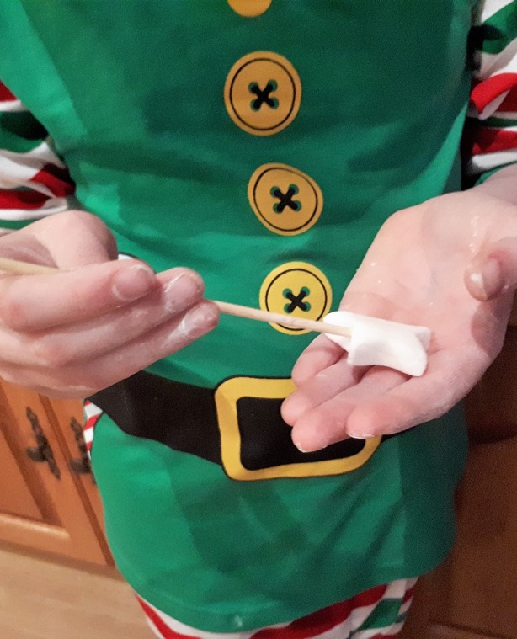
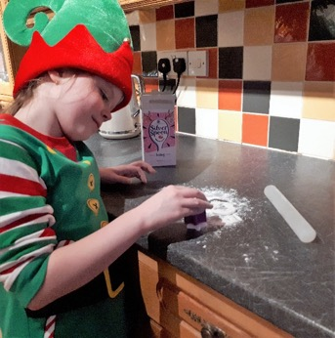
Cut out star
Using your smallest star shaped cookie cutter, cut out a star for the top of your tree.
Use the blunt end of your bamboo skewer to make a hole in edge of the star. Make sure you don’t go all the way through the star.
Cut
Notes:
Cut Star

Slide 19
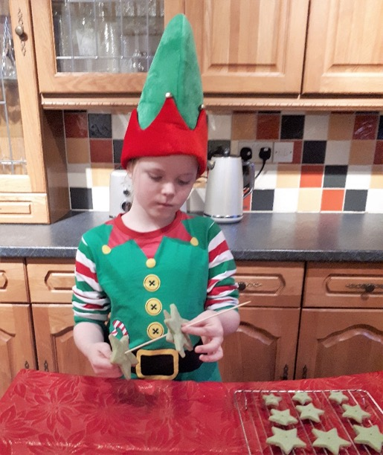
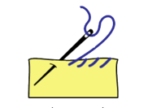
Thread biscuits
Thread the cooled biscuits onto the bamboo skewer, starting with the biggest biscuits first.
Thread

Slide 20
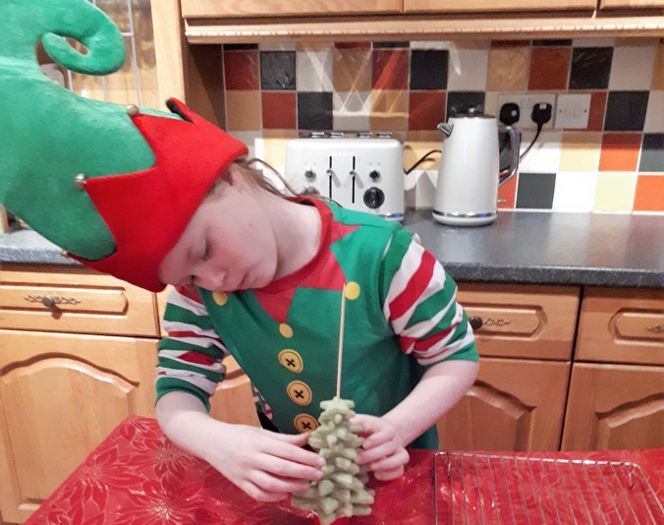
Stand on base
When all the biscuits are on the bamboo skewer, stand the blunt end of the skewer in your chosen weighted base.
Carefully twist the biscuits around to create the effect of a layered tree.
Stand / Put
Twist / Turn
Notes:
Stand on base

Slide 21
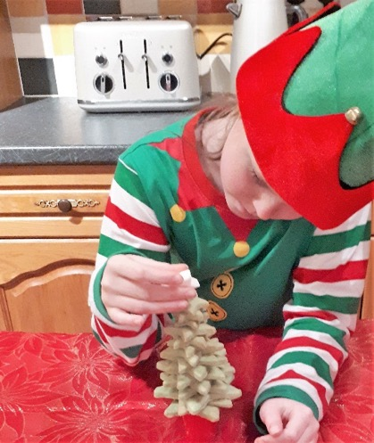
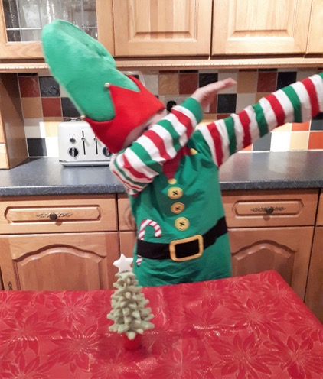
Star on top
Trim the sharp end of your bamboo skewer, so that it is only 1cm higher than the top of your biscuit tree.
Place your icing star on the bamboo skewer – and JOB DONE!
Trim
Place
DONE
Notes:
Star on top

Slide 22
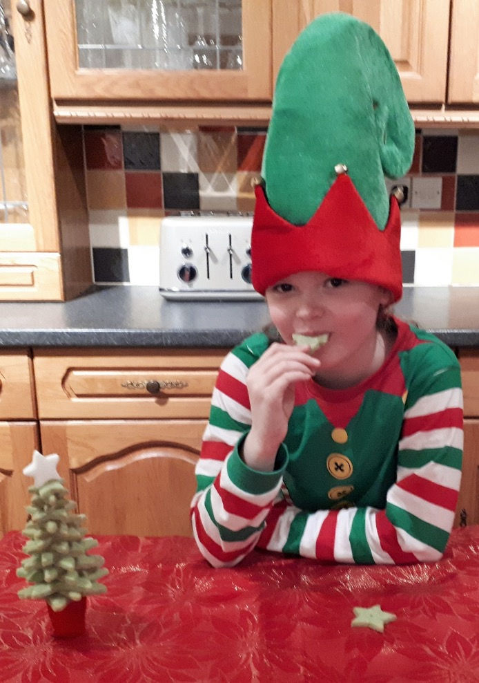
Eat it!
Now it’s time to eat it!
eat
Notes:
Eat it

Slide 23
Enjoy, and
Merry Christmas everyone!
Love
Jen x
© 2018 SymbolStix LLC All rights reserved. Used with permission.

